Slide 1
Online Banking Project DBMS
Aditya Nangia: 2020168
Meet Popat: 2020320
Mohammad Sufyan Azam: 2020312
Shourya Jindal: 2020336

Slide 2
Overview
•Physical Banking is very time and money consuming task. Going to bank for small objectives like money transfer, loans is very tedious.
•Thus in today’s time of internet we have implemented DATABASE of an ONLINE BANKING SYSTEM which saves time, redundancy of data and provides hassle free options to many operations like: Funds transfer, loans, FD, balance check, statement history etc.

Slide 3
StakeHolders
•Every customer with bank account
•Businesses
•Shops
•Students
•Bank Employees, managers
•Government

Slide 4
SCOPE
The main aim of an application is to somewhere automate records on the system. It gives all sorts of functions which are required by the bank in order to run a stable system.
•Creating New Accounts -The application can be used to create two different types of accounts
•Account Holders/Loan Borrowers List
•Employee and branch details
•Carry inter bank transactions and payments

Slide 5
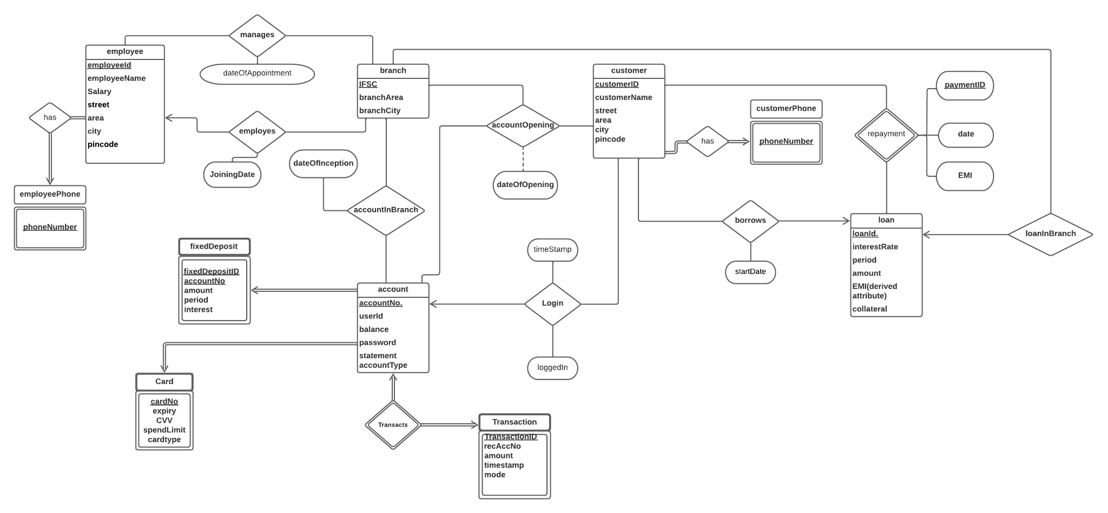
Updated ER diagram (Link)

Slide 6
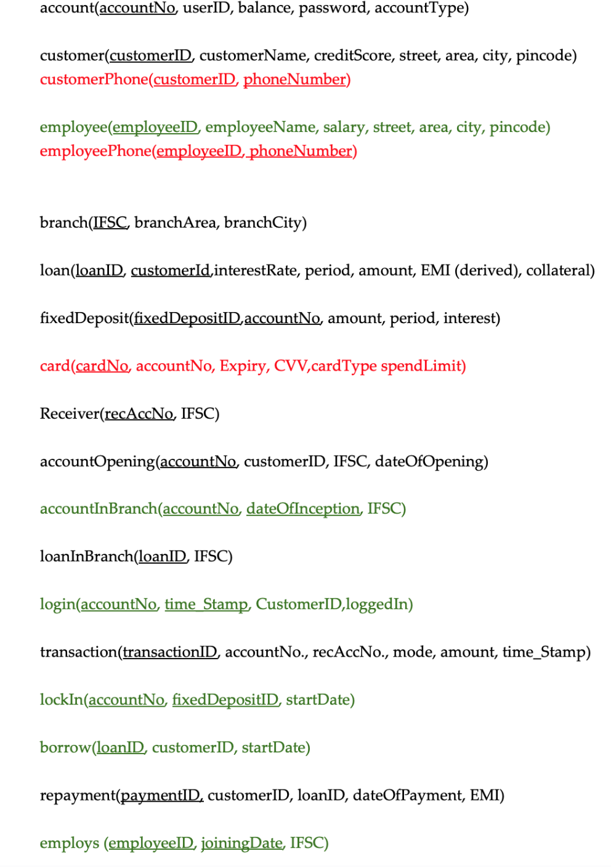
RELATIONAL SCHEMA(Link)

Slide 7
ASSUMPTIONS(Link)
1. On customer reg we give two accounts and one card per account
2. All loans and FD processed through one single branch
3. Same expiry date and spend limit for every card

Slide 8
VIEWS(Link)
VIEW 1: create view employee_view_cust (VIEW FOR EMPLOYEES TO SEE CUSTOMER DETAILS)
VIEW 2: create view manager_view_cust (VIEW FOR MANAGER tO SEE CUSTOMER DETAILS)
VIEW 3: create view manager_view_emp (VIEW FOR MANAGER TO SEE EMPLOYEES DETAILS)

Slide 9
INDEXING(Link)
CREATE INDEX idx_transact ON transaction(accountNo);
CREATE INDEX idx_acc ON account(accountNo);
CREATE UNIQUE INDEX idx_card ON card(accountNo);
CREATE INDEX idx_accOpen ON accountopening(customerID);
CREATE INDEX idx_customer ON customer(customerID);
CREATE INDEX idx_loan ON loan(loanID);
CREATE INDEX idx_FD ON fixeddeposit(accountNo);

Slide 10
TRIGGERS(Link)
TRIGGER 1: to create accounts on customer registration
Trigger 2: to set employee salary on each new employee registration
Trigger 3: for transaction updates
trigger 4: To create AccountInBranch
trigger 5: To create loanInBranch

Slide 11
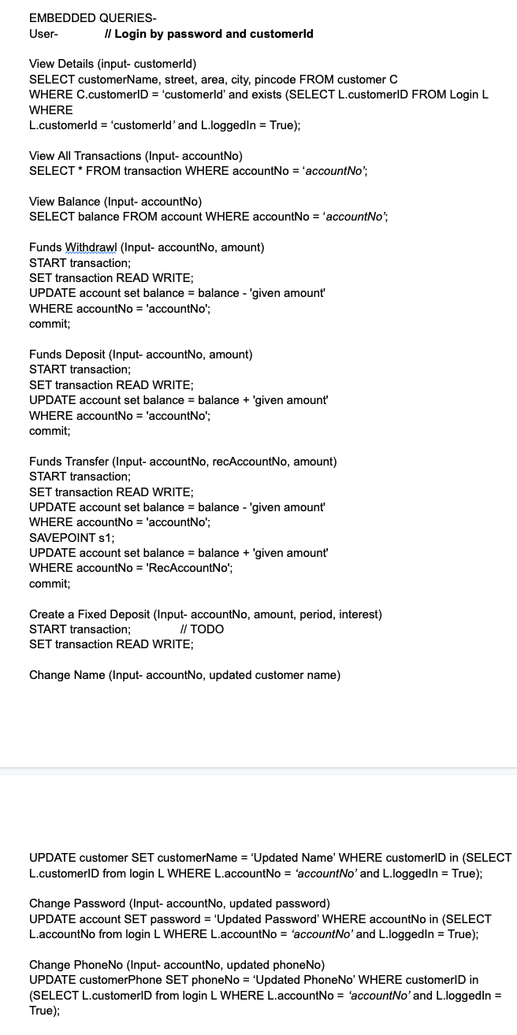
EMBEDDED SQL QUERIES(Link)

